Slide 1
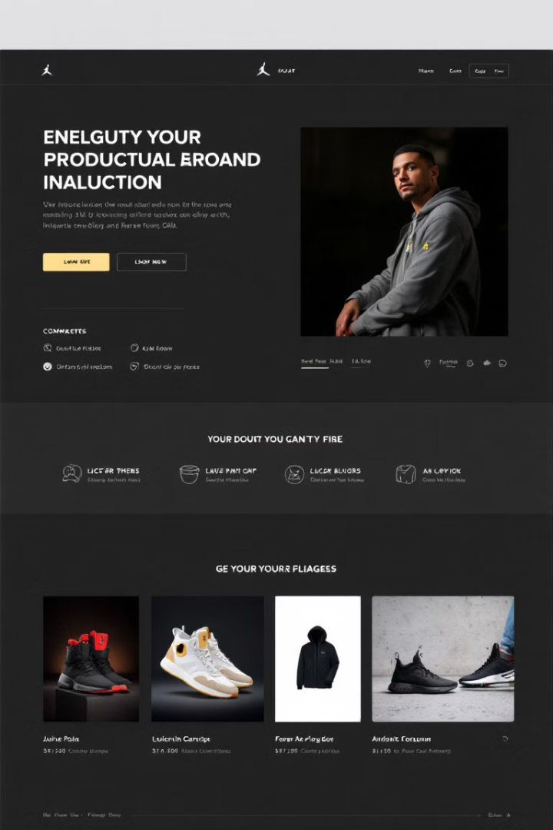
E-Commerce Website
Developing a successful e-commerce platform requires a strategic and comprehensive approach. This presentation will guide you through the key steps, challenges, and technologies involved in creating a professional online store that delivers an exceptional customer experience.
DONE BY:
SK Mudhaseer Ahamed(192211968)
M Shashe Vikaash (192211918)
Bramha (192210026)
GUIDED BY:
DR. K. Jayasakhthi Velmurugan

Slide 2

Introduction to E-Commerce and Project Objectives
1
E-Commerce Fundamentals
2
Key Objectives
The primary goals are to create an intuitive, user-friendly platform that drives online sales, enhances customer satisfaction, and streamlines the shopping experience.
E-commerce refers to the buying and selling of goods or services using the internet, enabling seamless transactions between businesses and customers.
3
Competitive Advantage
Delivering a top-notch e-commerce solution can help your business stand out in a crowded market and maximize revenue opportunities.

Slide 3
Aim and Challenges in Developing an E-Commerce Platform
Key Aims
Challenges
User Experience
Provide a seamless shopping experience, optimize conversion rates, ensure secure transactions, and drive customer loyalty.
Balancing user-friendliness, performance, scalability, and complex integrations (payments, inventory, shipping, etc.).
Crafting an intuitive, visually appealing interface that guides customers through the purchase journey.

Slide 4
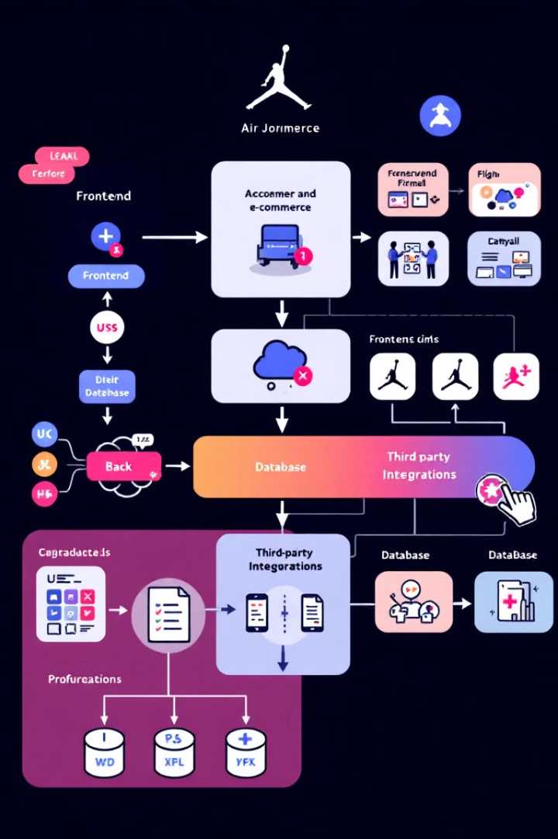
Proposed System Design and Architecture
1
Frontend
It is the top most layer of the Architecture. Responsive, user-friendly interface built with HTML, CSS, and JavaScript to deliver an optimal browsing experience.
2
Backend
Powerful server-side logic using PHP to handle product management, order processing, and customer data management. Handles all the processing and decision making logic of the application.
3
Database
MySQL database for efficient storage and retrieval of product information, customer data, and transaction history.

Slide 5

Frontend and Backend Technologies
Frontend
Backend
Third-Party Integrations
HTML, CSS, and JavaScript for building the responsive and visually appealing user interface.
PHP for implementing server-side logic, handling business rules, and integrating with the database.
Leverage APIs and SDKs to seamlessly integrate payment gateways, shipping providers, and other essential services.

Slide 6
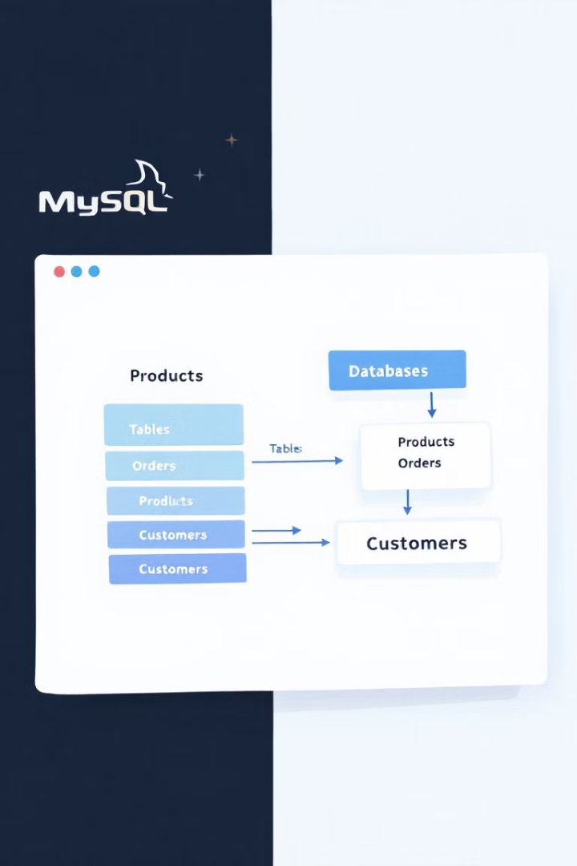

Database and Storage: MySQL
Scalable Storage
MySQL database provides a robust, scalable, and reliable solution for storing and managing e-commerce data.
Data Security
Ensure the integrity and confidentiality of customer information and transaction records.
High Performance
Optimized database design and efficient query execution for fast data retrieval and processing.

Slide 7
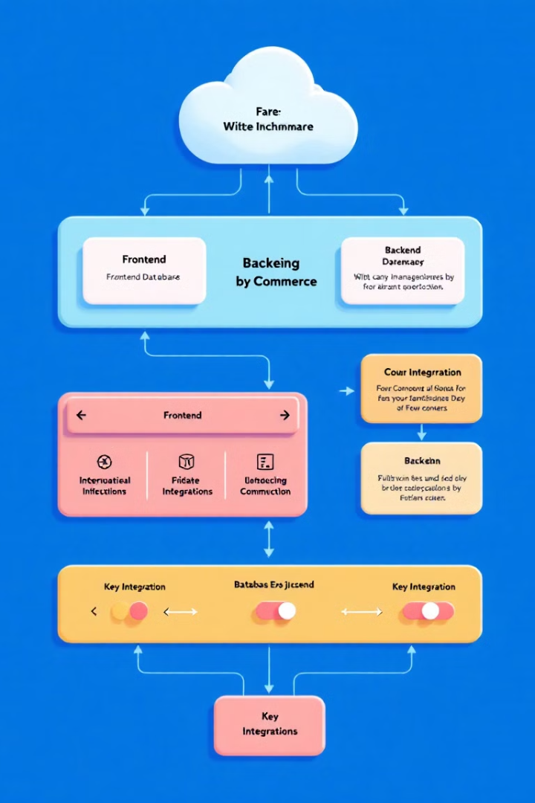




Block Diagram of E-Commerce Website
User Interface
Responsive, visually appealing frontend for seamless user experience.
Business Logic
Robust backend systems for handling product management, orders, and customer data.
Database
Secure and scalable MySQL database for storing and retrieving e-commerce data.
Integrations
Seamless integration with payment gateways, shipping providers, and other third-party services.

Slide 8

Project Modules and Development Phases
1
Requirements Analysis
Understand user needs, define project scope, and establish clear objectives.
2
Design and Architecture
Create the system architecture, user interface wireframes, and technical specifications.
3
Development and Integration
Implement the frontend, backend, database, and integrate third-party services.
4
Testing and Deployment
Conduct comprehensive testing, address any issues, and deploy the e-commerce platform.

Slide 9
Core Features: Product Catalog, Shopping Cart, Checkout
Product Catalog
Shopping Cart
Secure Checkout
Intuitive interface for browsing and searching products, with detailed descriptions, images, and pricing information.
Seamless addition, modification, and removal of items, with real-time updates to the total cost and shipping details.
Streamlined checkout process with multiple payment options, order review, and confirmation, ensuring a safe and trusted experience.

Slide 10

Conclusion and Future Enhancements
1
Delivering a Powerful E-Commerce Solution
2
Ongoing Improvements
Continuously enhance the platform with features like personalized recommendations, loyalty programs, and advanced analytics to stay ahead of the competition.
The proposed e-commerce platform combines robust technology, user-centric design, and seamless integrations to drive online sales and customer satisfaction.
3
Future Opportunities
Explore emerging technologies, such as AI-powered chatbots and voice-enabled shopping, to elevate the customer experience and unlock new revenue streams.

Slide 11

THANK YOU

